Slide 1


Predict Customer Personality to boost marketing campaign by using Machine Learning
Created by:
Philipus Dima Wira Pratomo
pwirapratomo@gmail.com
https://www.linkedin.com/in/philipus-dima-wira-pratomo-a221391ab/
Graduated from Pertamina University majoring in petroleum engineering with a GPA of 3.78. Currently I want to shift career to data scientist by attending a data science bootcamp. where I am developing expertise using data visualization tools such as Tableau and Looker Studio, SQL and several Python libraries to create machine learning. My objective is to become a professional data scientist and leverage my skills to contribute to data-driven decision-making in diverse industries.

Slide 2
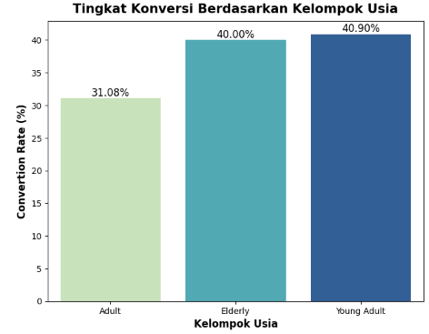
Conversion Rate Analysis Based on Age
Elderly and young adults have a conversion rate of approximately 40%.
Adults exhibit the lowest conversion rate, which is around 31%.
To see more details, you can refer to the Jupyter notebook here

Slide 3
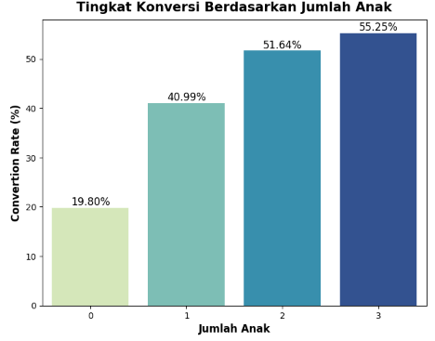
Conversion Rate Analysis Based on Total Children
Overall, there is a positive correlation between the number of children and the Conversion Rate (CVR), indicating that as the number of children increases, the CVR also tends to rise.
Customers with three children exhibit the highest CVR, approximately 55.25%.
Conversely, customers without any children demonstrate the lowest CVR, around 19.80%.
To see more details, you can refer to the Jupyter notebook here

Slide 4
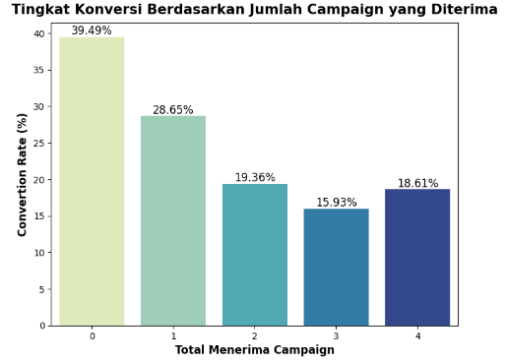
Conversion Rate Analysis Based on Total Accepted Campaign
In broad strokes, the fewer customers who accept the campaign, the higher the conversion rate (CVR).
This demonstrates that the likelihood of the existing campaign being less appealing is high.
Because the existing campaigns do not seem to enhance the current transaction volume.
The highest CVR is observed among customers who do not receive the campaign at all, reaching 39.49%.
To see more details, you can refer to the Jupyter notebook here

Slide 5
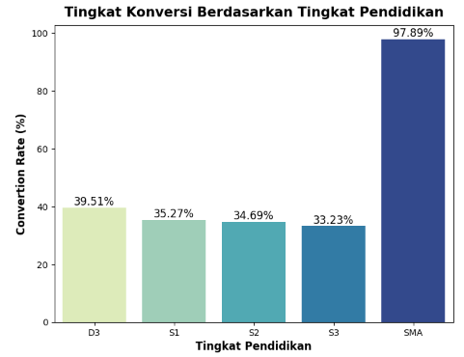
Conversion Rate Analysis Based on Academy Level
If looked at overall, the levels of education have the same conversion rate (CVR) except for high school (SMA), which has the highest CVR at 97.89%.
To see more details, you can refer to the Jupyter notebook here

Slide 6
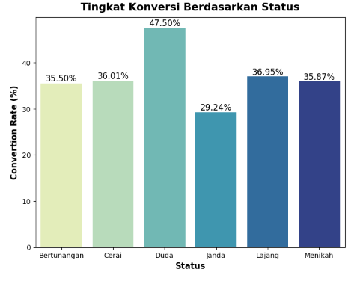
Conversion Rate Analysis Based on Status
Duda boasts the highest Conversion Rate (CVR) at an impressive 47.50%.
Janda, on the other hand, exhibits a lower CVR, standing at 29.24%.
To see more details, you can refer to the Jupyter notebook here

Slide 7
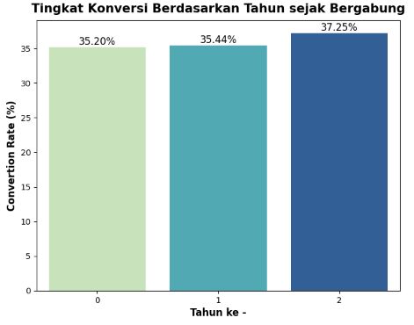
Conversion Rate Analysis Based on Years Since Join
The longer the customer has been a member, the higher the conversion rate (CVR), although the difference is not prominently noticeable.
The highest point is at 2 years, reaching 37.25%.
The lowest point is less than 1 year, around 35.20%.
To see more details, you can refer to the Jupyter notebook here

Slide 8
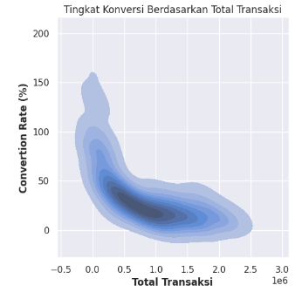
Conversion Rate Analysis Based on Years Since Join
The lower the total transaction amount, the higher the Conversion Rate (CVR).
The majority of customers have a total transaction amount ranging from 500,000 to 1,000,000, with a corresponding CVR of approximately 0% to 50%.
To see more details, you can refer to the Jupyter notebook here

Slide 9
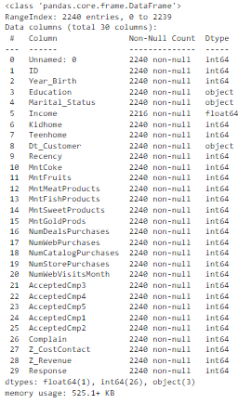
Overview
Description
Dataset contains customer behavior features on our platform
Shape
Dataset memiliki 2,240 records dan 30 fitur
Dtype
Float64 (1 features), int64 (26 features), object (3 features)
To see more details, you can refer to the Jupyter notebook here

Slide 10
Data Preprocessing
Checking Data Type
Fitur Dt_Customer could change into Date
Checking Missing Value
There are 24 null values in the Income feature, and they will be filled with the median of the data.
Checking Duplicate Value
There are no duplicate
To see more details, you can refer to the Jupyter notebook here

Slide 11
Feature Engineering
Feature Convertion Rate
Division of total purchases by total visitors.
Feature Umur and Kelompok Umur
Since there is no information on when this data was collected, the last date in Dt_Customer is used as a reference to create the age feature and categorize it based on:
1. Less than 17 years = Child
2. 19 - 44 years = Young Adult
3. 45 - 74 years = Adult
4. More than 75 years = Elderly
Feature days_since_join
Since there is no information on when this data was collected, the last date in Dt_Customer is used to determine how long a customer has been a member.
Feature Total Transaksi
Summing up all the total expenditures.
Feature Total Anak
The number of children the customer has.
Feature Total Menerima Campaign
The number of customers who received the campaign.
To see more details, you can refer to the Jupyter notebook here

Slide 12
Remove Unneeded Features
There is a feature that can be removed as it only has one data point and has already undergone feature engineering :
1. Unnamed: 0
2. ID
3. Year_Birth
4. Z_CostContact
5. Z_Revenue
6. Kidhome
7. Teenhome
8. Dt_Customer
9. MntCoke
10. MntFruits
11. MntMeatProducts
12. MntFishProducts
13. MntSweetProducts
14. MntGoldProds
15. NumDealsPurchases
16. NumWebPurchases
17. NumCatalogPurchases
18. NumStorePurchases
19. NumWebVisitsMonth
20. NumWebVisitsMonth
21. AcceptedCmp4
22. AcceptedCmp5
23. AcceptedCmp1
24. AcceptedCmp2
25. AcceptedCmp3
To see more details, you can refer to the Jupyter notebook here

Slide 13
Feature Encoding
Feature encoding will be performed on :
Education
Marital_status
To see more details, you can refer to the Jupyter notebook here

Slide 14
Standarisasi dan Hapus Outlier
Outlier Handling
Standarisasi
Outlier removal will be conducted on the following features:
1. Age
2. Income
The number of rows before filtering out the outliers is 2240, while the number of rows after outlier removal is 2229.
Standardization will be applied to the following features:
1. Income
2. Recency
3. total_pembelian
4. total_transaksi
To see more details, you can refer to the Jupyter notebook here

Slide 15
Feature Selection
To segment customers, there is a method known as RFM Analysis :
Name | Meaning | Column That Used
Recency | Measuring how recently customers make a purchase | Recency
Frequency | frequently do customers make purchases or engage with the business | total_pembelian
Monetary | Measuring the total amount of money spent by customers | total_transaksi
Loyalty | Consumer Loyalty | total_accepted_campaign
To see more details, you can refer to the Jupyter notebook here

Slide 16
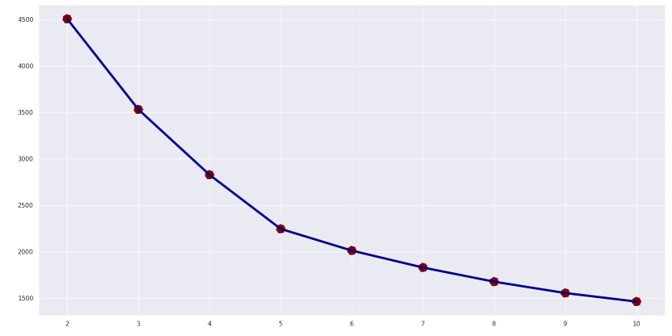
Elbow Score
In the provided Elbow Score below, it is evident that when the number of clusters is set to 5, the inertia score does not change significantly.
Elbow Point
To see more details, you can refer to the Jupyter notebook here

Slide 17
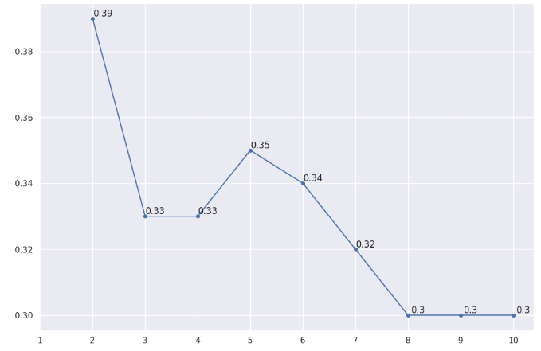
Silhouette score
In the Silhouette score below, it is evident that when the number of clusters is set to 5, it exhibits the highest silhouette score compared to others, specifically at 0.35.
Best Silhouette Score
To see more details, you can refer to the Jupyter notebook here

Slide 18
Customer Personality Analysis for Marketing Retargeting
The results of the clustering that has been carried out previously can be interpreted based on the characteristics of each group, how the cluster tends to respond to existing marketing campaigns, and what the potential revenue results will be if we carry out marketing retargeting to that cluster.
To see more details, you can refer to the Jupyter notebook here

Slide 19
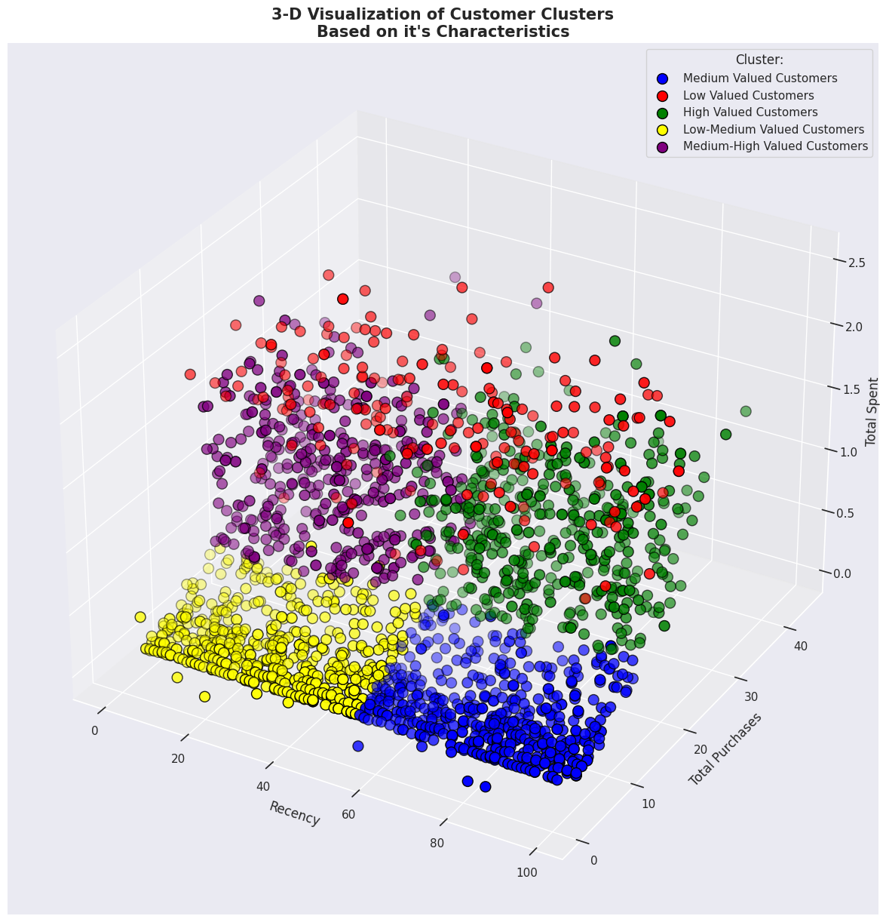
3-D Visualization of Customer Clusters
The results of dividing customers based on characteristics produce 5 sections, which have been divided based on Recency, Total Purchases and Total Spents. Where the 5 parts are referred to as:
Low Valued Customers
Low-Medium Valued Customers
Medium Valued Customers
Medium-High Valued Customers
High Valued Customers
To see more details, you can refer to the Jupyter notebook here

Slide 20
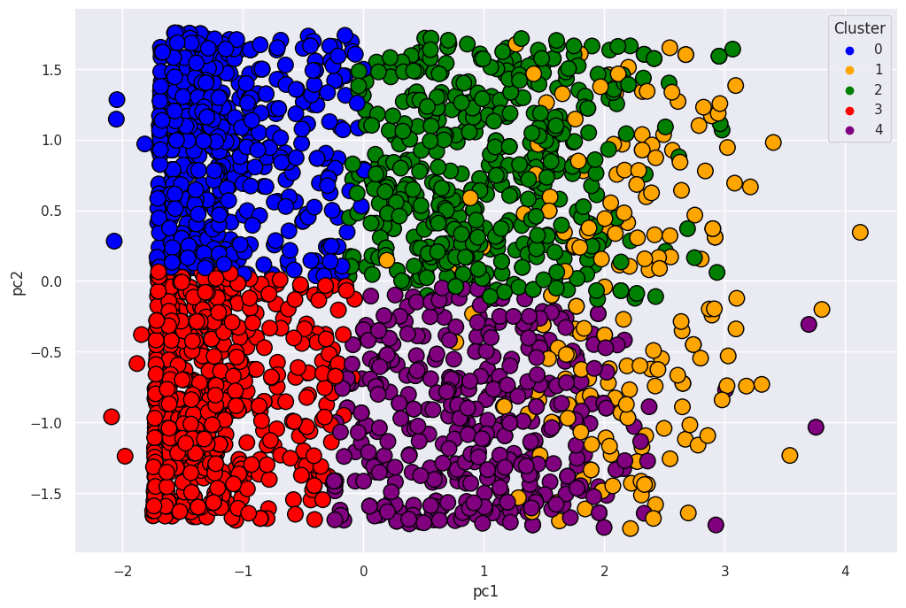
PCA
Because it is difficult to see the detailed division between the 5 groups because it uses 3 dimensions. So PCA is carried out to clearly see the division between each customer group
To see more details, you can refer to the Jupyter notebook here

Slide 21
Characteristics Each Group of Customers
To see more details, you can refer to the Jupyter notebook here

Slide 22
Business Recommendation
Provide Premium Product and Service Offers to High-Value Customers in order to maintain a strong relationship with them, which can yield long-term benefits while maximizing revenue from this customer segment and ensuring a satisfying shopping experience.
For Low and Low-Medium Value customers with low income characteristics, they tend to visit the website but often do not engage in transactions. Furthermore, it appears that only a small percentage of them are responsive to the campaigns being offered. Therefore, it is essential to reevaluate the campaign strategy for this customer group, ensuring that it is better tailored to their needs, prompting them to not only visit the website but also complete transactions.
To see more details, you can refer to the Jupyter notebook here

Slide 23
Potential Impact
If we continue to focus on Customer Groups/Clusters and prevent them from churning, there is still a potential GMV of approximately IDR 1.3 billion per year. With the detail below.
To see more details, you can refer to the Jupyter notebook here

